Slide 1
EE6470 Final project
110061546 邱博昇

Slide 2
Outline
The algorithmn
The structural
Result

Slide 3
The algorithmn
polynomial rolling Hash
parameter:
s: string
n: string length
p: 31
m: 10⁹ +9

Slide 4
The algorithmn
convert each character of string to an integer.
a~z is convert to the 1~26
example:
if string = sugar
hash value
= (19 * 310 + 21 * 311 + 7 * 312 + 1 * 313 + 18 * 314) % m
= 16660566 % 1000000009
= 16660566

Slide 5
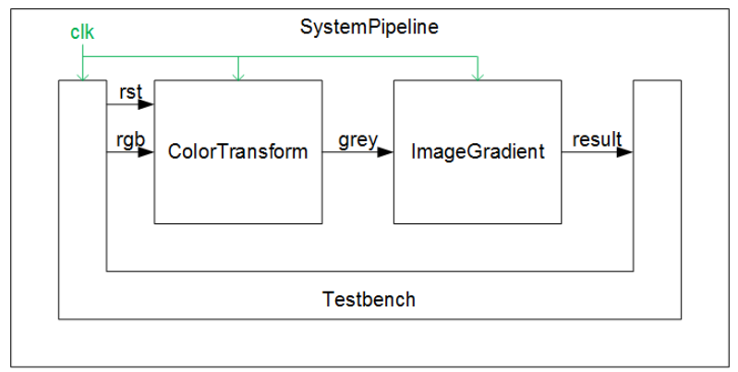
The HLS structural
rst
ProductSum
sum
modulo
result
char

Slide 6

The riscv-vp structural
core0
core1
dbg_if
DMA connecter
SimpleBus< 4 , 7 >
Simple memory
Syscall Handler
CLINT
PLIC
Hash0
Hash1
DMA

Slide 7
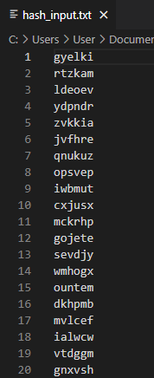
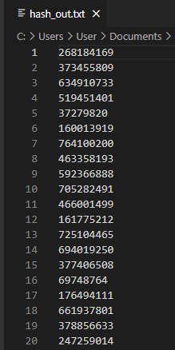
Result Data (input and output)
input
output

Slide 8
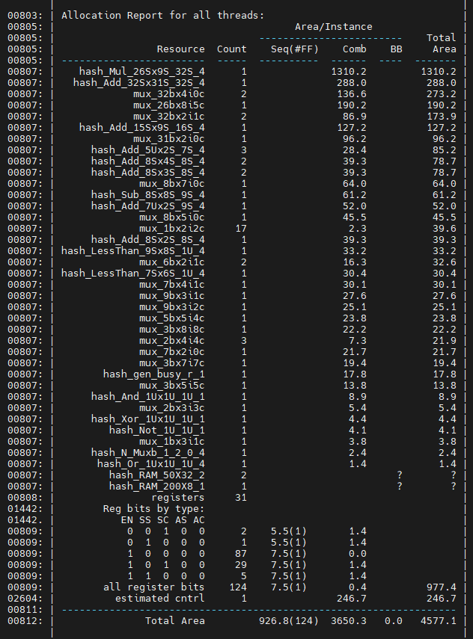
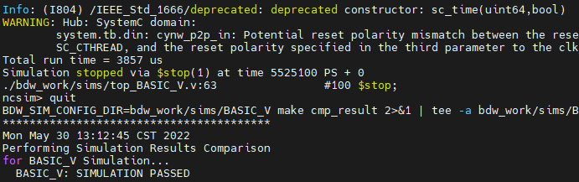
Result HLS (BASIC)
AREA : 4577.1
Run time : 3857000 ns

Slide 9
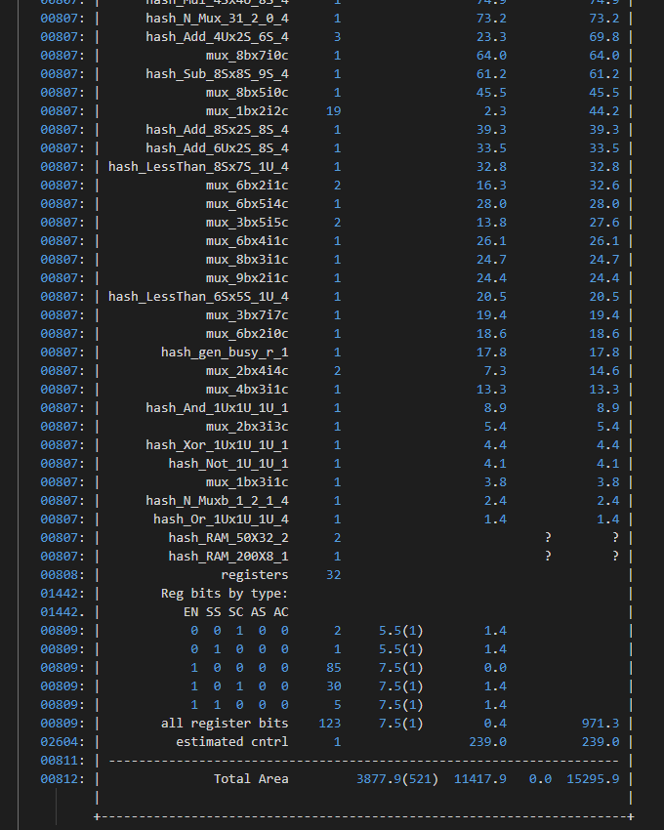
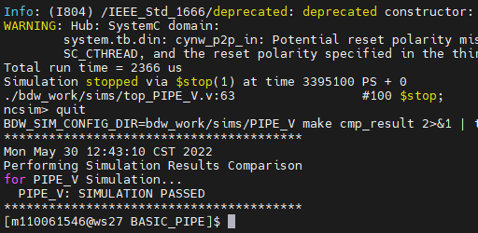
Result HLS (PIPELINE)
AREA : 15295.9
Run time : 2366000 ns

Slide 10
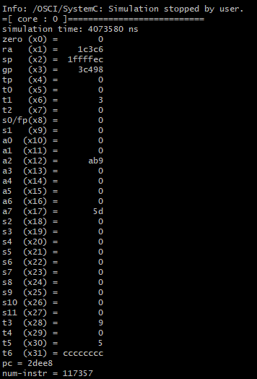
Result RISCV-VP (Single core)
simulation time: 4073580 ns
num-instr : 117357

Slide 11
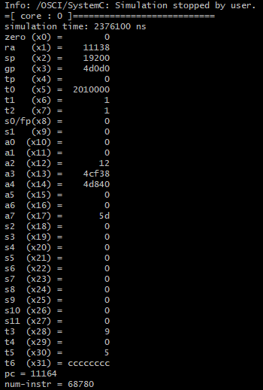
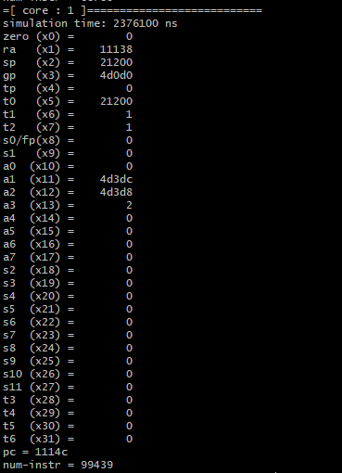
Result RISCV-VP (two core)
simulation time: 2376100 ns
num-instr : 168219

Slide 12
Result
HLS:
 | AREA | RUN TIME
BASIC | 4577.1 | 3857000 ns
PIPELINE | 15295.9 | 2366000 ns
RISV-VP:
 | simulation time | num-instr
one core | 4073580 ns | 117357
two core | 2376100 ns | 168219

Slide 13
Thank you

